Slide 1


Architecture Proposal
Farmacy Food Case
Notes:
We are ArchColider and this is our architectural proposal for Farmacy Food.

Slide 2

Business Goals
A “ghost kitchen” (cooking facility set up for the preparation of delivery-only meals.) needs an ordering system to allow users to have visibility of what items are available, purchase, and pick-up items at any one of their points of sale / smart-fridge.
Business Drivers (BD)
System support and engage occasional users to purchase to increase the user base, converting Occasional users to Known users and Known users to Subscribers.
System provides rich options for engaging known users and subscribers by different kinds of loyalty programs. New options are easily added to increase user satisfaction and a chance of recommendation.
System provides information about consumed meals and on-demand requests to support Ghost Kitchen management.
System should be easy to use for inexperienced users to increase the user base.
Sustainable usage of service.
Involve other specialists in health areas to increase userbase.
Notes:
Farmacy Food requires an ordering system that will connect its users with ghost kitchens. Based on startup requirements, we identified business drivers that guided us through designing architecture..

Slide 3








Assumptions
Assumptions
Smart Fridge
Ghost Kitchen
Development Team
API endpoint
API endpoint
The team is small
Emits refillment events
No 24/7 working hours
Cross-functional
Scheduled meals produced daily
Aware about location
Meal have unique tracking id
Notes:
we have the following global assumptions about the IT landscape. We assume that smart fridges and ghost kitchen systems already have API, and we can communicate with them. Additionally, we assume the ghost kitchen operates during regular working hours, not 24h per 7. Finally, the development team is small but experienced.

Slide 4









Constraints and Scope
Dev Team
Budget
Time-to-Market
Platform
User App
Feedback
Ghost Kitchen
PoS Terminals
Smart Fridges
Notes:
Requirements and assumptions lead us to constraint and scope, and more importantly, what is out of scope. No extensions or modification of smart fridges or ghost kitchen systems expected.

Slide 5
Significant Architectural Drivers
# | Significant Architectural Drivers (SAD) | From BD
1 | System support cash and electronic payments | 1
2 | Pluggable system of feedback, survey, review abilities | 1, 2
3 | On-time reports about consumed meals from fridges. Breakdown by subscribers and occasional buying | 3
4 | Scheduling system for subscribers, to avoid repetitive operations of ordering | 1, 3, 4, 5
5 | Ability to purchase without registering first | 1, 4, 5
6 | Notification system to inform the user about their orders | 1, 4, 5
7 | Notifications about new loyalty programs and coupons | 2, 5
8 | Detailed break down of a meal by components in catalog | 1, 5, 6
9 | Secure payments | 1, 5
10 | Maximizing guarantee of a meal picking up by user | 1, 5
Notes:
Significant architectural drivers usually make budget and architects SAD ‘cause it shows the amount of necessary work ahead. Requirements traceability is key.

Slide 6
Stakeholders
Owner
Ghost Kitchen
PoS Admins
Nutritionists
Subscribers
Admins
Known users
Developers
Occasional users
Food suppliers
3rd party kitchens
Notes:
We remember about stakeholders, even about tech guys and food suppliers and what they care about

Slide 7
Stakeholders
Stakeholder | Concerns
Ghost Kitchen | Get information about prepared and delivered meals consuming to predict supply refilment
 | Get information about on-demand orders
Subscribers | Create a menu and getting meals on time
 | Get notification about arriving or delayed food to save their time
 | Be informed about meal ingredients
Known users | Browse catalog and buy food with guarantee of getting it when they come to pick it up
 | Ease of buying process
 | Be informed about meal ingredients
Occasional users | Visually select a meal, get info about it and pay in the most convinient way at same time
Owner | Attract all type of users
 | Improve quality of provided food and service
 | Information about users preferences
 | Support for accounting system
Nutritionists | Search in catalog by specific components
 | Calculation % of fats\carbs\vitamins...
Developers | Ease of maintaining and developing the system
Admins | Ease of monitoring
 | Ease of configuration and scaling
Food suppliers | Predicted plan of purchases and delivery
3rd party kitchens | Same as for Ghost Kitchen
PoS Admins | Only meals from fridges installed locally should be visible in the App
 | Ease access to a meal ingredients and allergens
 | Ease of registration selling operation
 | Automatic report generation about selling activity
Owner
Ghost Kitchen
PoS Admins
Nutritionists
Subscribers
Admins
Known users
Developers
Occasional users
Food suppliers
3rd party kitchens

Slide 8
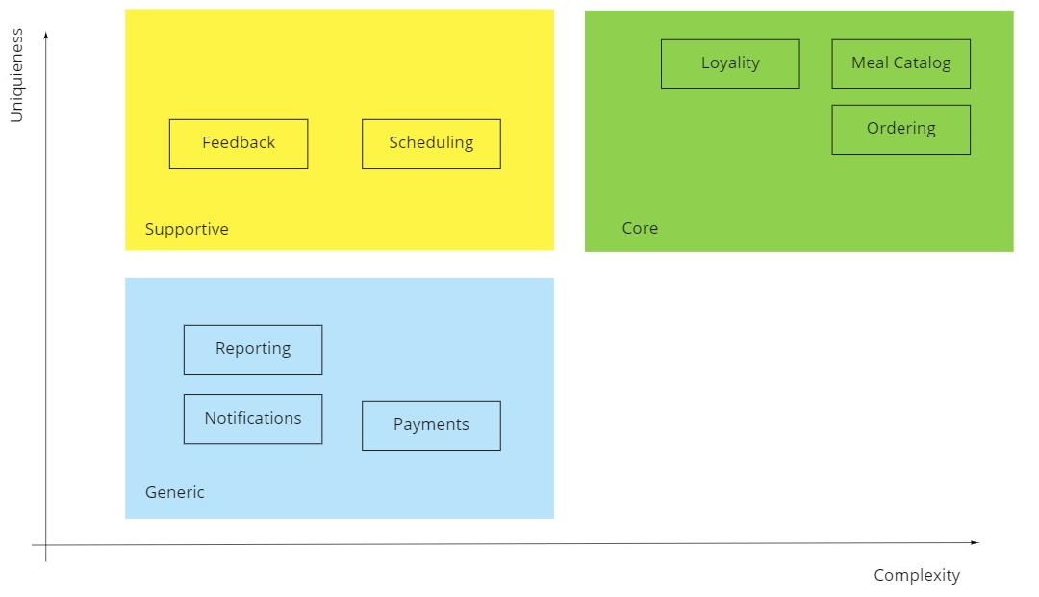
Solution overview
STRATEGIC DOMAIN DESIGN
Categorization by Core, Generic and Support helps identify subdomains and prioritize development efforts.
Core – custom made software
Support – buy and customize
Generic – buy
Notes:
Moving to solution. Domain area is sophisticated, and we decided to use domain driven approach to handle complexity. Not all parts of the system equally important, so we need to know what we build or buy.

Slide 9
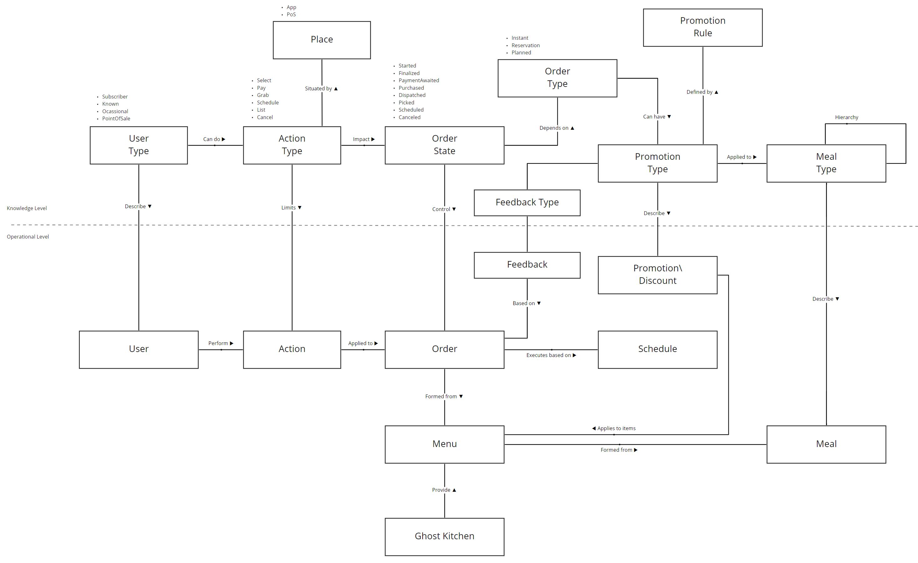
Solution overview
CONCEPTUAL DESIGN
Notes:
Conceptual map helps validate business scenarios and connections between entities. Rules connected on knowledge level proves that system keep its logical integrity
Also it helps to think about future possible business cases, that are not existed now.
And here is an example of case for promotion campaign based on meal type.

Slide 10
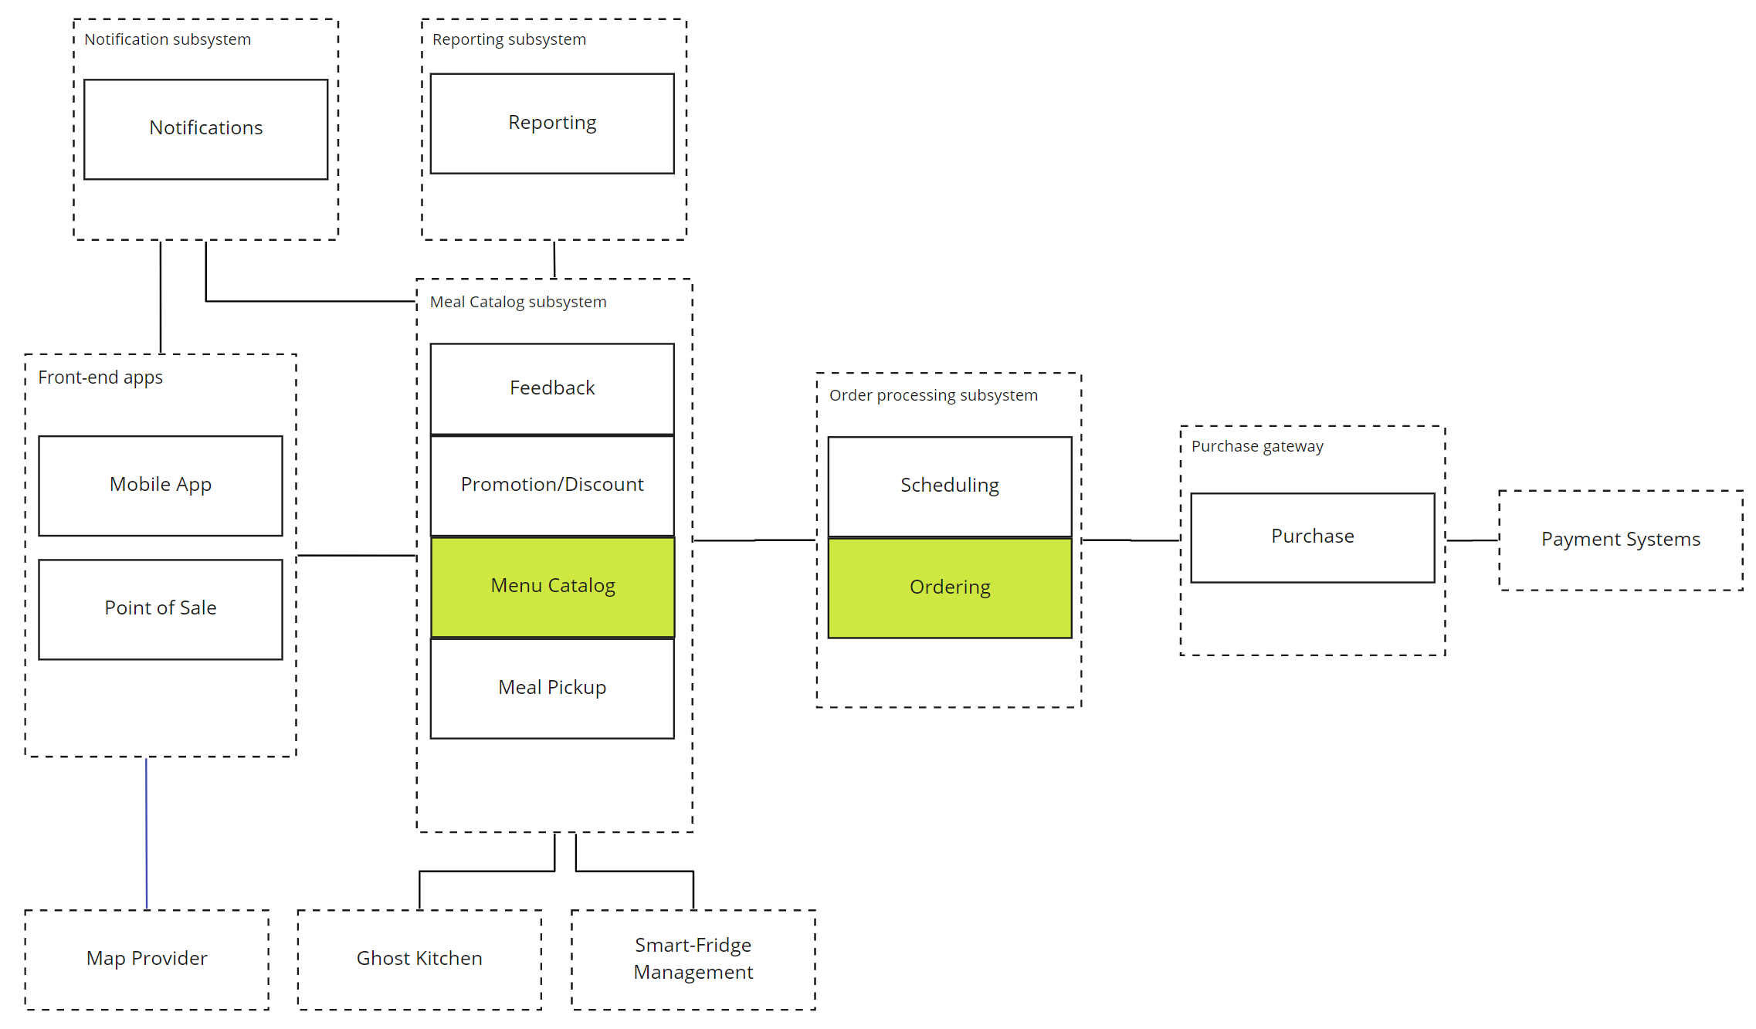
Solution overview
MODULARIZED MONOLITH(S)
Notes:
From the technical perspective, we offer modularized monolith, a set of them. The centers of functional gravity are Meal Catalog and Ordering modules.

Slide 11


Quality Attributes
DOMINATING
Simplicity
We'd like to provide initial simplicity for the overall system but that do not close the window for further extraction of services and independent development and deployment.
Grouping functional areas to benefit from the ease of development and deployment.
Modifiability
The second important part is to provide points of extensions and ease of modifiability for the proposed solution. It means subparts can be extracted and extended without massive refactoring.
Notes:
To start thinking about the next architectural patterns, we need to identify quality attributes. Simplicity and Modifiability are dominating qualities across the system. Remember constraints?

Slide 12
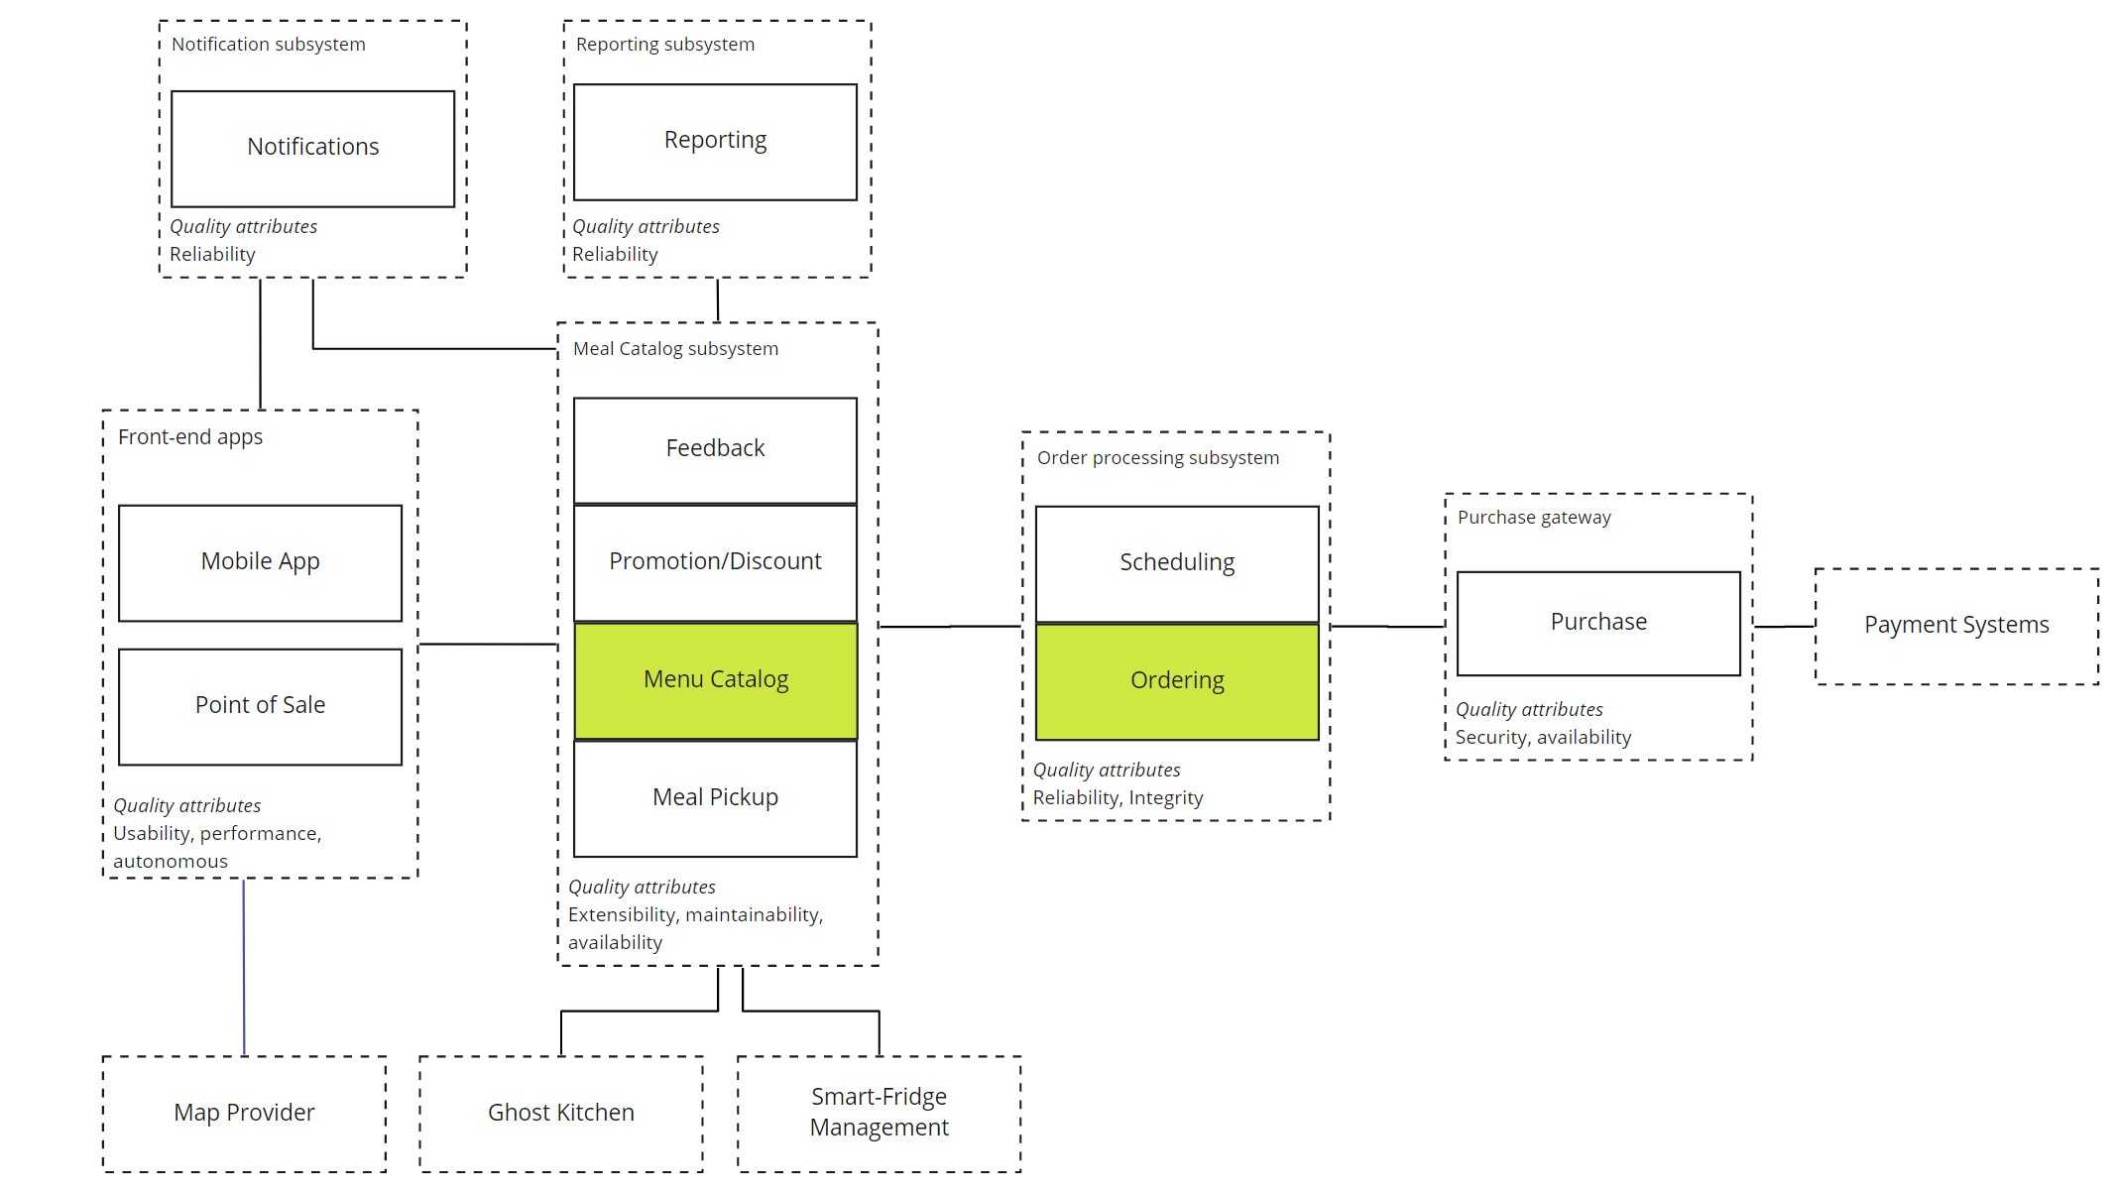
Quality Attributes
BY SUBSYSTEMS
Notes:
However, every subsystem will have additional set of essential quality attributes. It helps to pick correct patterns based on the specific needs of each subsystem.

Slide 13
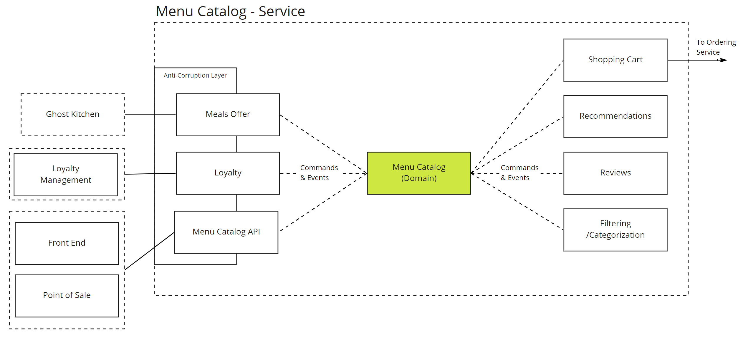
System Design
COMMANDS & EVENTS
Notes:
To address modifiability and extensibility, we’ll use commands and events for communication between logical parts in monolith. Doing so from the beginning, we ensure that extraction of any module won’t be so painful because commands and events should flow as before.

Slide 14
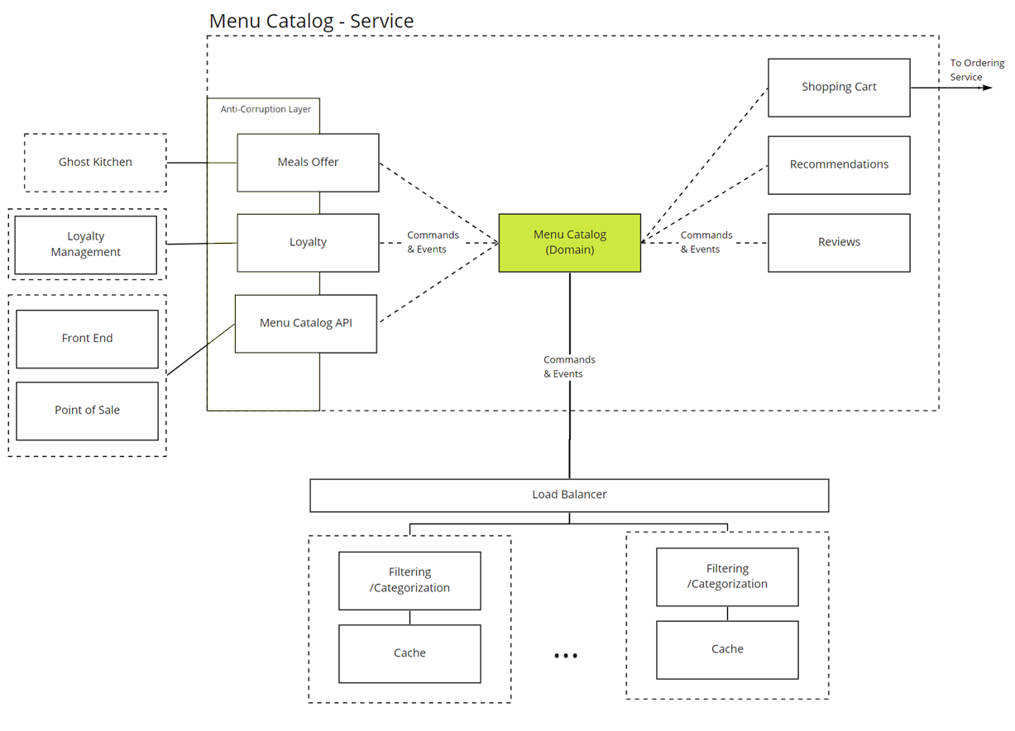
System Design
EXTRACTION CASE
Notes:
If everything is done right – then extraction should be easy with communication and security checks in place

Slide 15
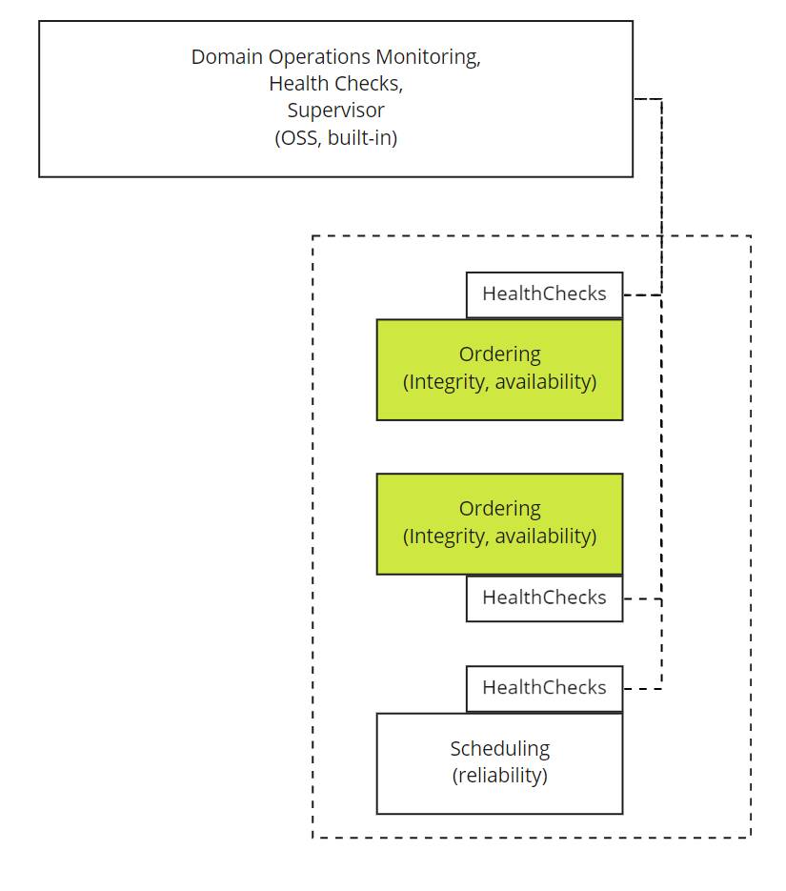
System Design
MONITORING
HealthCheck end points provide information about:
Readiness to start business communication
Internal metrics of business request processing
Technical metrics (requests rate, failure rate)
Notes:
All decisions about extracting or scaling services are based on facts. Metrics trend analysis should be used as fitness functions.

Slide 16
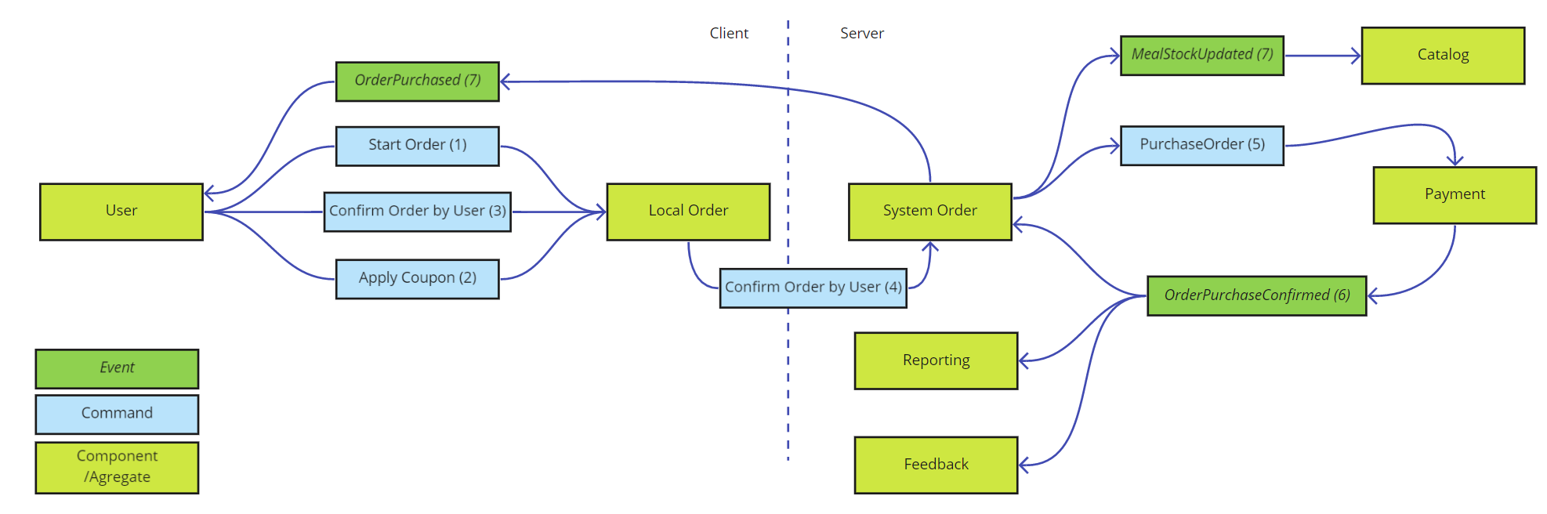
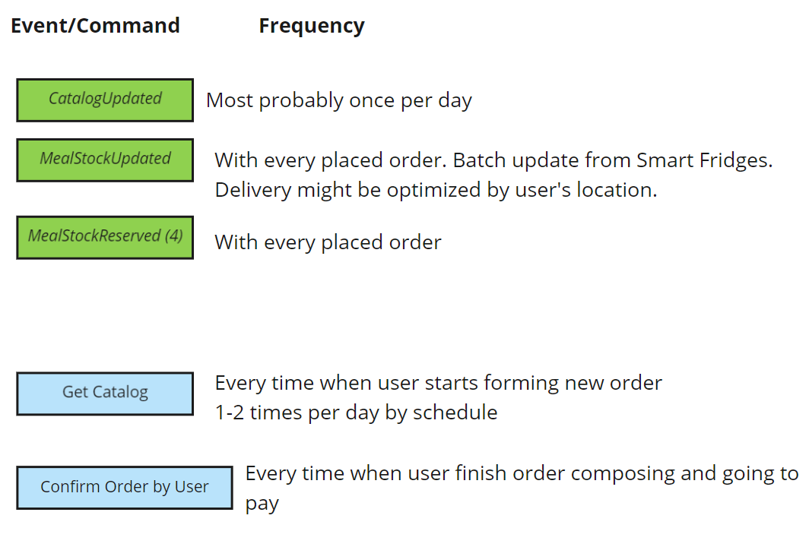
Information View
MEAL PURCHASE SCENARIO
Make Order Request | Length | Size (bytes)
user_guid | 1 | 16
meal_guid | 1 | 16
kitchen_guid | 1 | 16
pos_guid |  | 16
notes | 500 | 2000
http_header | 300 | 600
#Requests | Day | Week | Month
500 | 1.27 | 8.89 | 35.57 | MiB
1000 | 2.54 | 17.78 | 71.14 | MiB
5000 | 12.70 | 88.92 | 355.68 | MiB
10000 | 25.41 | 177.84 | 711.36 | MiB
Notes:
Not all things can be fitted on system diagram and we moving to specific information view. Here we illustrate our decision to cache catalog on client device and send to backend only formed order, for additional checks and payment process.
We estimate number of messages and size that help to provide cost analysis later.

Slide 17
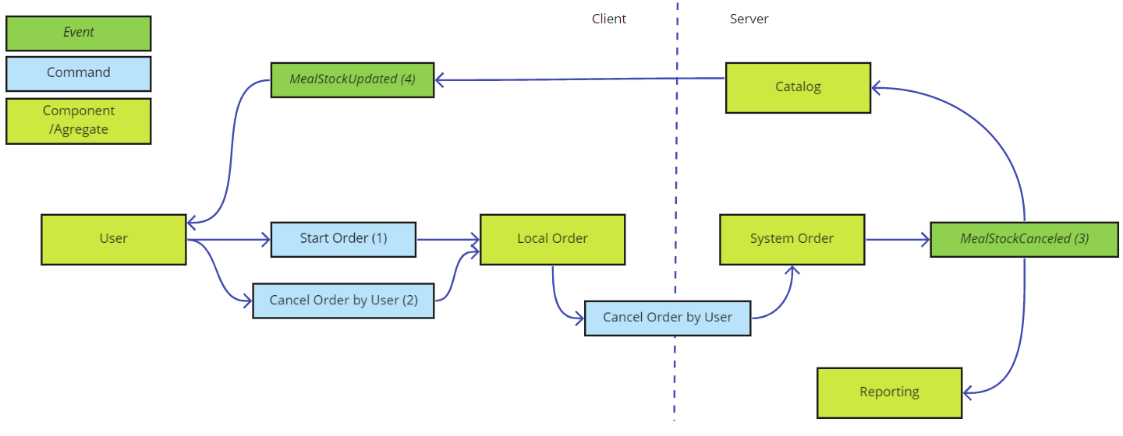
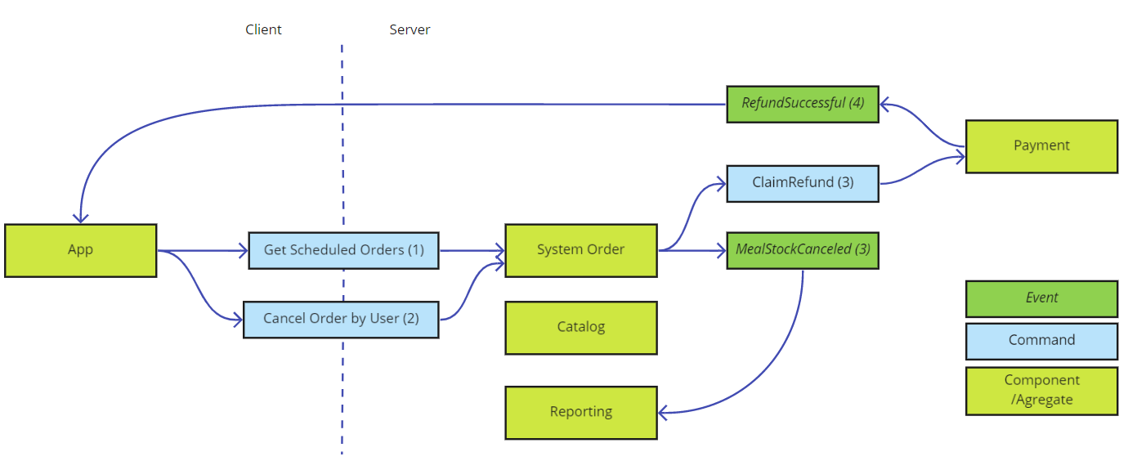
Information View
CANCELATION SCENARIOS
Order cancelation
Scheduled order cancelation
Notes:
Conceptual map and quality attributes maped to user journeys help a lot in designing information flow.

Slide 18
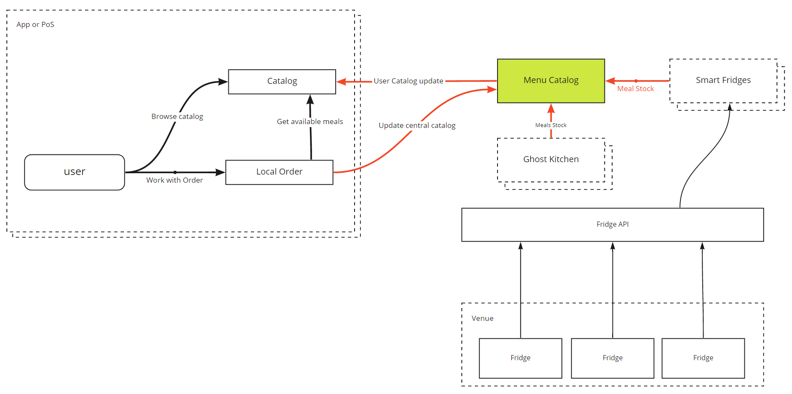
Concurrency View
AVAILABLE NUMBER OF MEALS IN CATALOG
Notes:
On concurrency view we show potentially risky situation with concurrent updates of available meals, but the catalog should keep data consistency

Slide 19
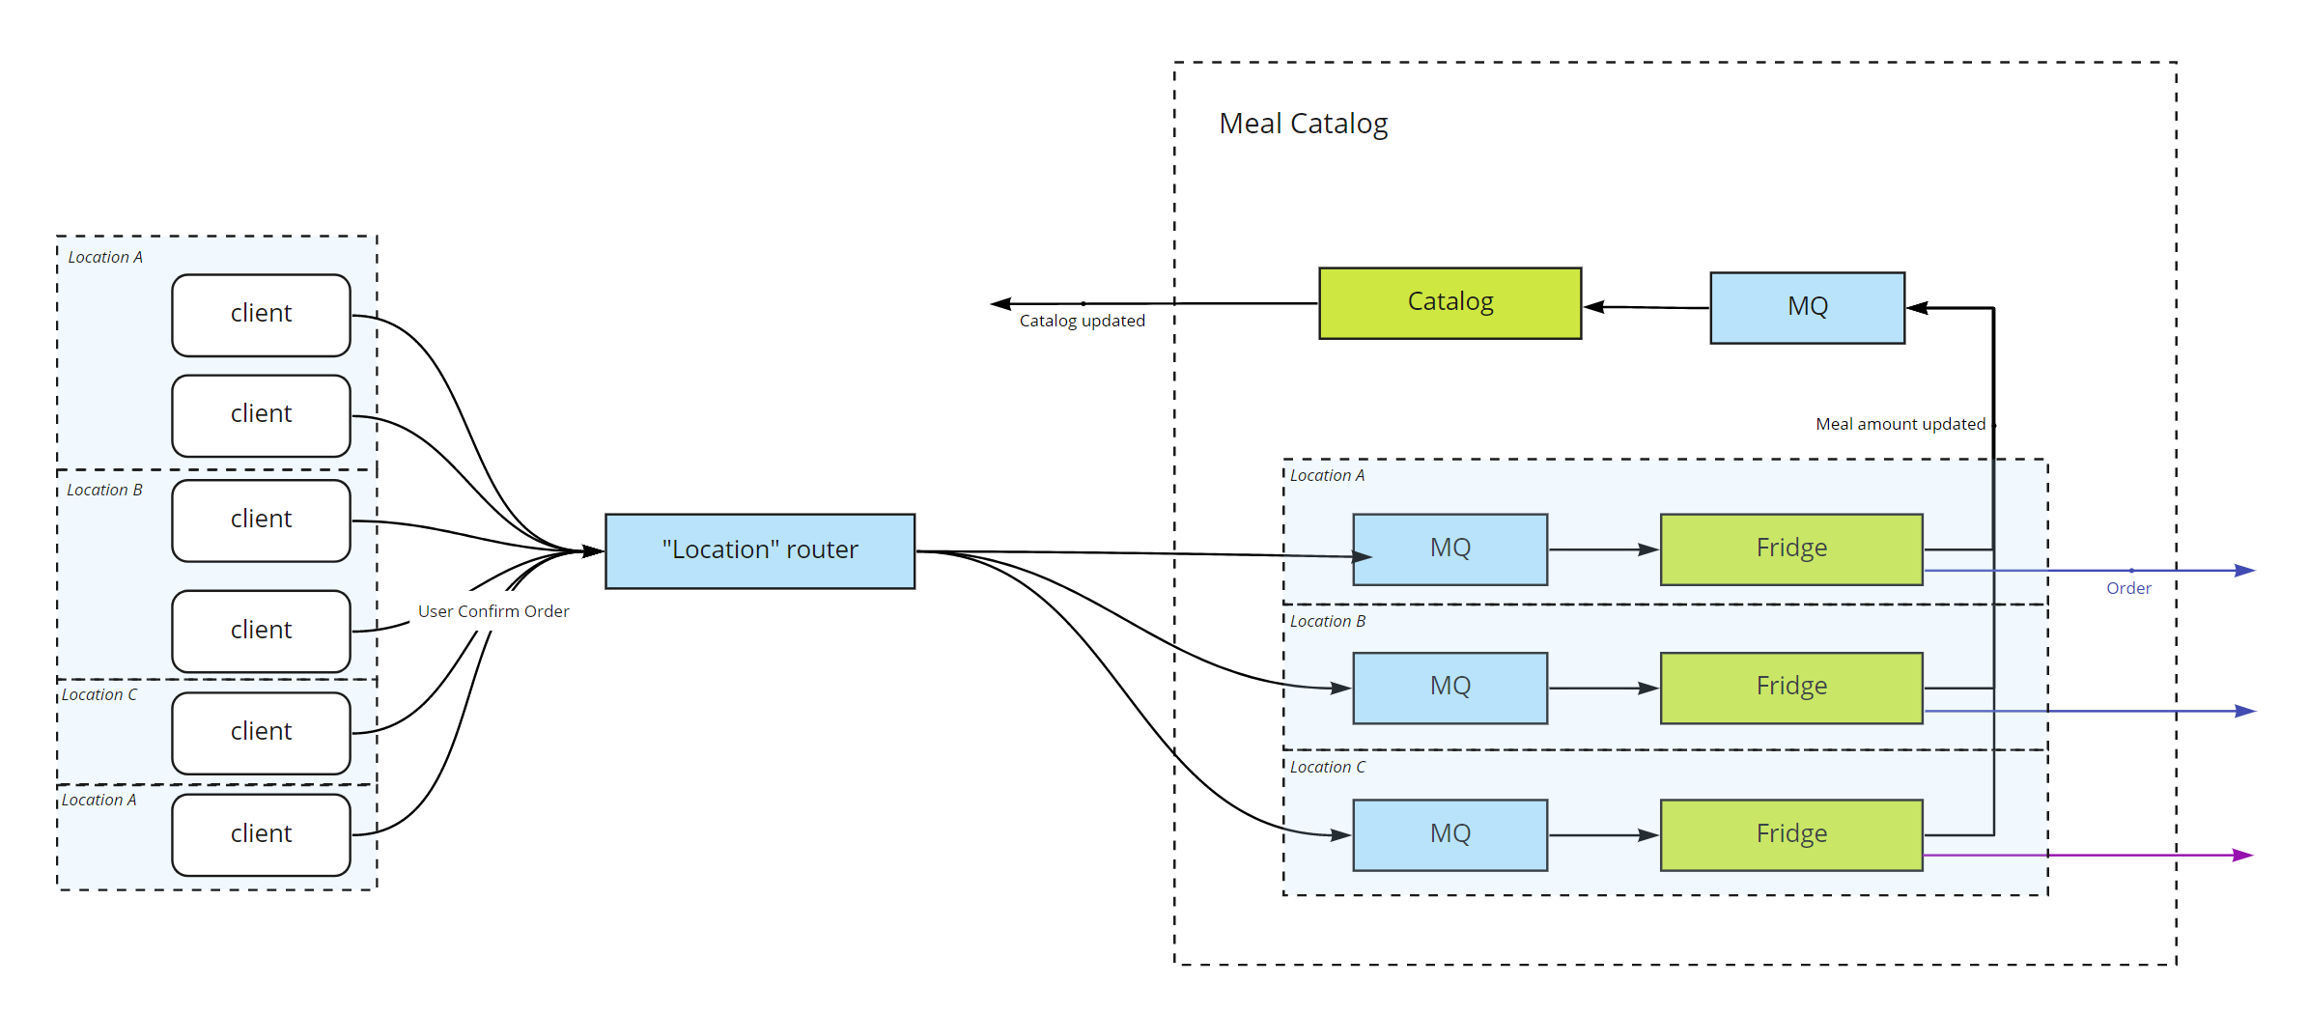
Concurrency View
AVAILABLE NUMBER OF MEALS IN CATALOG
ACTORS
Notes:
We propose to use the actor pattern because we have actor pattern implementation in life - fridges. A user always buys from a specific fridge, and a meal can’t magically jump from one fridge to another.

Slide 20
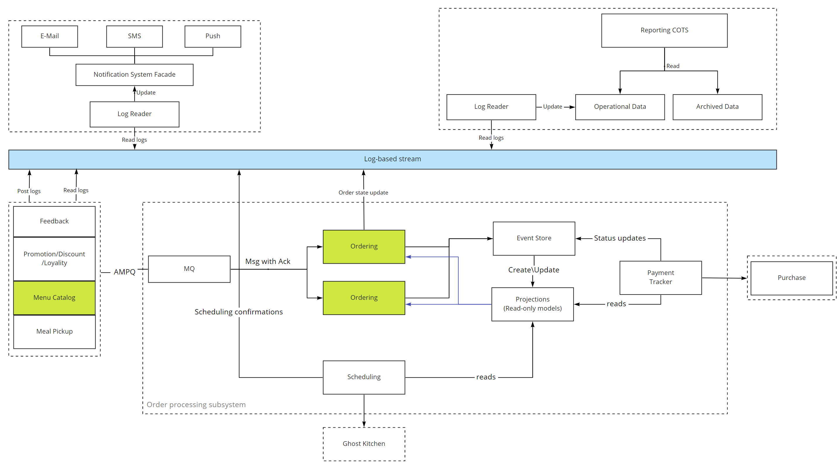
Concurrency View
INTERCOMPONENT COMMUNICATION SCENARIO
Notes:
To avoid concurrency issues on the system level, we offer to use log-based streaming software. Someone said Kafka?

Slide 21
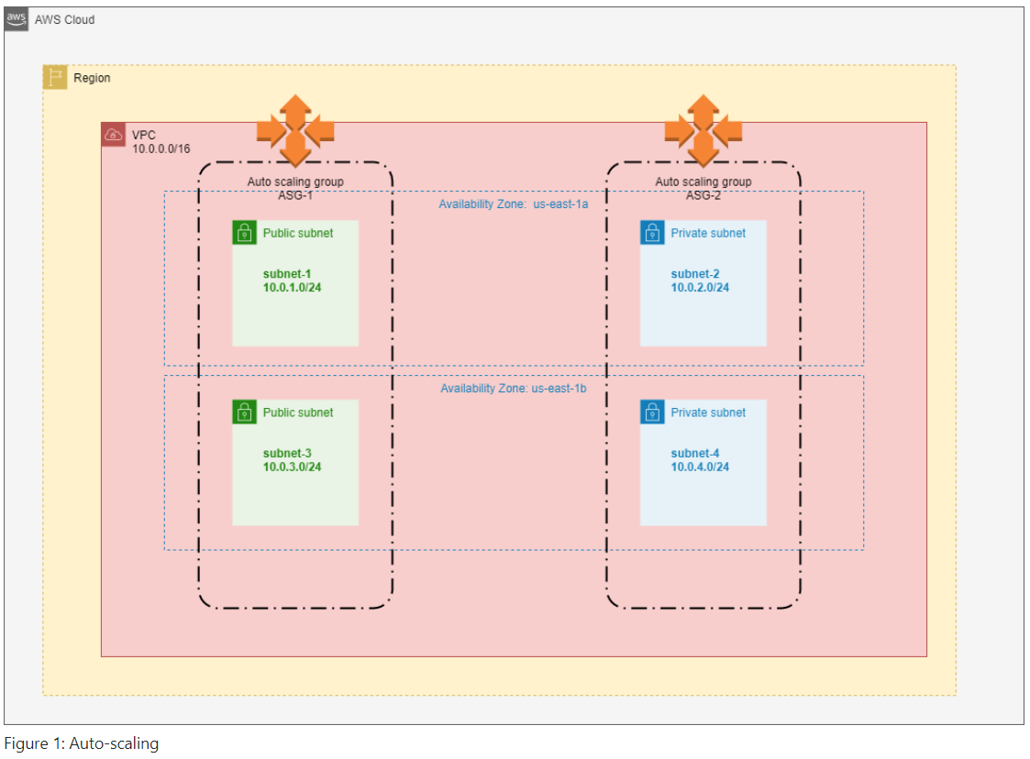
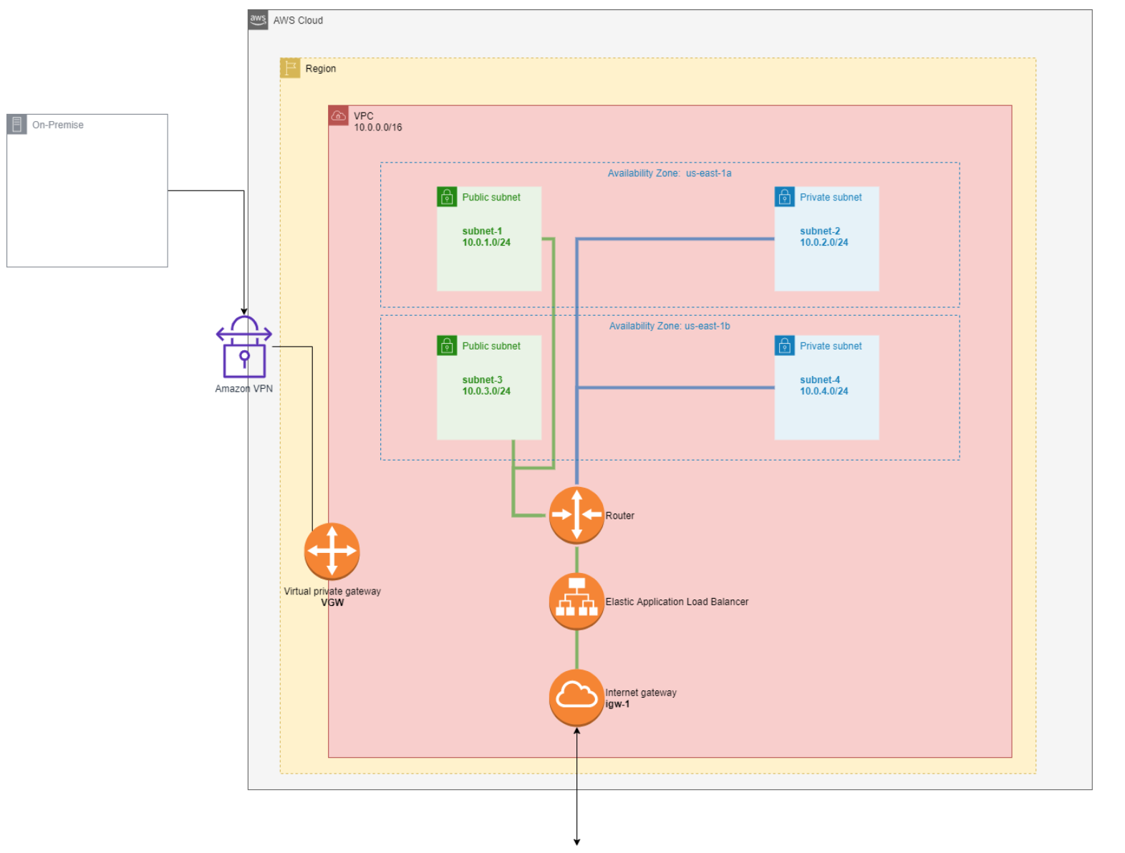
Infrastructure View
Scaling
VPC Design
Notes:
Infrastructure view allows us to understand the cost of the solution. We suggest the first scale vertically - it will be cheaper and faster as the system's load is small at the beginning. Then fitness functions should guide scaling process.

Slide 22
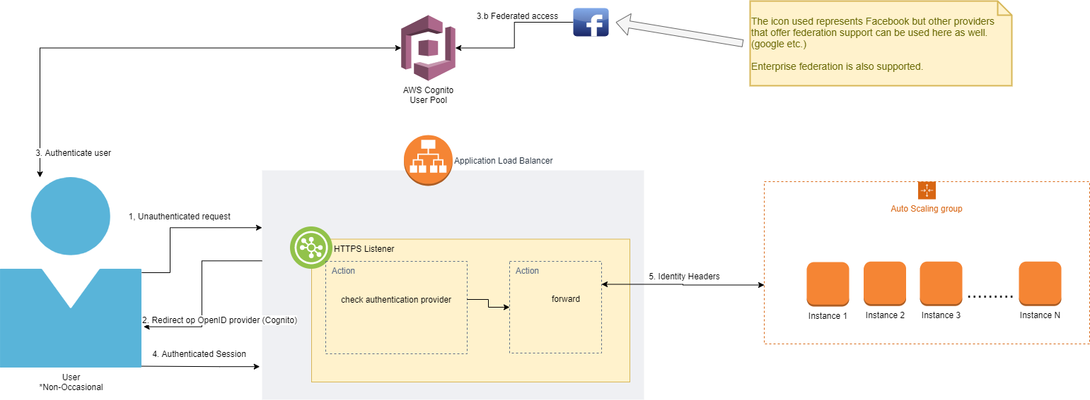
Security View
Notes:
Solution support farmacy food accounts and the ability to use 3rd party identity providers.

Slide 23
Cost Analysis
Service | 1-year TCO at minimum | 1-year TCO at projected growth
EC2 | 3,114.96 USD | 3,114.96 USD
VPN | 9.13 USD | 9.13 USD
AMAZON MQ | 508.32 USD | 546.72 USD
AMAZON S3 Buckets | 262.32 USD | 524.52 USD
AMAZON Dynamo DB | 3,072.00 USD | 3,072.00 USD
Application Load Balancer | TBD | TBD
Kafka Managed Streams | 138.72 USD | 138.72 USD
Tableau | 1,440.00 USD | 1,440.00 USD
DataDog | 3,336.00 USD | 3,336.00 USD
SNS | 366.12 USD | 366.12 USD
Data Transfer out | TBD | TBD
TOTAL | 12,247.57 USD | 12,548.17 USD
Notes:
Cost analysis might raise questions about the need for services. Still, ADRs should have answers or open discussions with owners about possible solutions.

Slide 24
Risks and Sensitive Points
Technical Risks
Payment provider's service is temporarily down.
Spawning too many service instances lead to money wastes.
Ghost Kitchen is down and does not provide information about meals availability
Not applying security practices.
Risky releases with significant changes.
Breaking changes in message formats for internal or external services.
Mismatch of production and development environment
Business related risks
The catalog is stale, and reserved food can't be dispatched from the selected smart-fridge.
Subscriber's menu can't be prepared.
Notification about delivery or meal can't be delivered by preferred channel.
PoS app disconnected from the network.
Smart fridge disconnected from the network.
User booked a meal but did not pick it up.
Meal is stuck in the fridge.
Notes:
Having a list of technical risks is good. Even better, is to have a list of business related risks. Because a variety of solutions is broad, and only the owner can decide how to handle risk.

Slide 25
Risks and Sensitive Points
Technical sensitive points
Modern cloud scaling technologies allows scaling up for a long time that might postpone decisions about scaling out.
Service overloaded. Options:
Proactive monitoring
Circuit breaker
Dog Pile protection
Business related sensitive points
Subscribers and Known users make an over provisioning situation for a fridge. Not all food can be placed in a fridge.
Order was placed during off hours of Ghost Kitchen.
Review bombing for 3rd party kitchens.
Notes:
The same with sensitive points. Review bombing is not expected but possible.

Slide 26
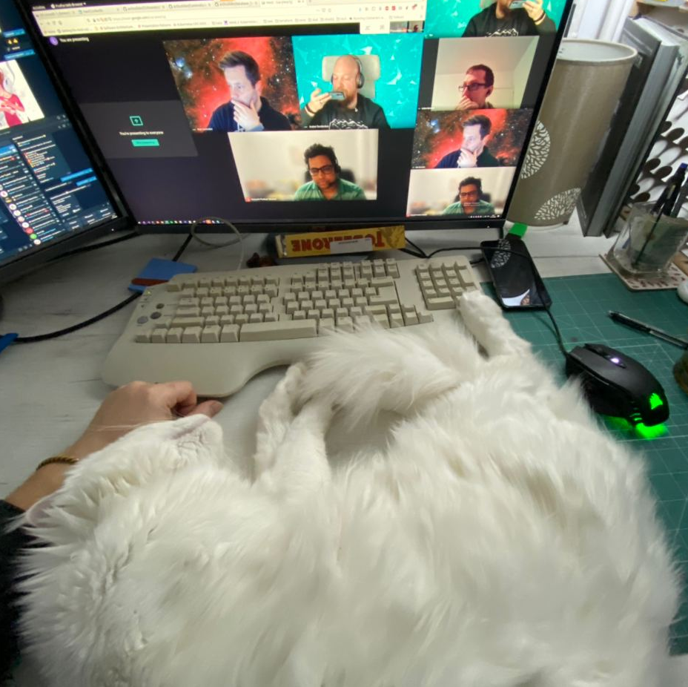
Andrei, Han, Hemanth, Lukasz
https://github.com/ldynia/archcolider
Notes:
Thank you for attention, more info in our repo.

